Slide 1
Signal Processing First
Lecture 8
Sampling & Aliasing
© 2003, JH McClellan & RW Schafer

Slide 2
READING ASSIGNMENTS
This Lecture:
  Chap 4, Sections 4-1 and 4-2
    Replaces Ch 4 in DSP First, pp. 83-94
Other Reading:
  Recitation: Strobe Demo (Sect 4-3)
  Next Lecture: Chap. 4 Sects. 4-4 and 4-5
© 2003, JH McClellan & RW Schafer

Slide 3
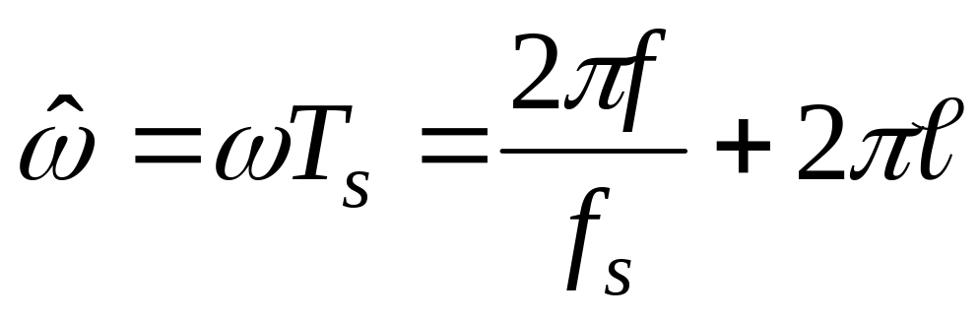
LECTURE OBJECTIVES
SAMPLING can cause ALIASING
  Sampling Theorem
  Sampling Rate > 2(Highest Frequency)
Spectrum for digital signals, x[n]
  Normalized Frequency
ALIASING
© 2003, JH McClellan & RW Schafer

Slide 4
SYSTEMS Process Signals
x(t)
SYSTEM
y(t)
PROCESSING GOALS:
  Change x(t) into y(t)
    For example, more BASS
  Improve x(t), e.g., image deblurring
  Extract Information from x(t)
© 2003, JH McClellan & RW Schafer

Slide 5
System IMPLEMENTATION
ANALOG/ELECTRONIC:
    Circuits: resistors, capacitors, op-amps
x(t)
ELECTRONICS
y(t)
DIGITAL/MICROPROCESSOR
    Convert x(t) to numbers stored in memory
x(t)
A-to-D
x[n]
COMPUTER
y[n]
D-to-A
y(t)
© 2003, JH McClellan & RW Schafer

Slide 6
SAMPLING x(t)
SAMPLING PROCESS
    Convert x(t) to numbers x[n]
    “n” is an integer; x[n] is a sequence of values
    Think of “n” as the storage address in memory
UNIFORM SAMPLING at t = nT_{s}
    IDEAL: x[n] = x(nT_{s})
x(t)
C-to-D
x[n]
© 2003, JH McClellan & RW Schafer

Slide 7
SAMPLING RATE, f_{s}
SAMPLING RATE (f_{s})
  f_{s} =1/T_{s}
    NUMBER of SAMPLES PER SECOND
  T_{s} = 125 microsec → f_{s} = 8000 samples/sec
      UNITS ARE HERTZ: 8000 Hz
UNIFORM SAMPLING at t = nT_{s} = n/f_{s}
  IDEAL: x[n] = x(nT_{s})=x(n/f_{s})
x[n]=x(nT_{s})
x(t)
C-to-D
© 2003, JH McClellan & RW Schafer

Slide 8
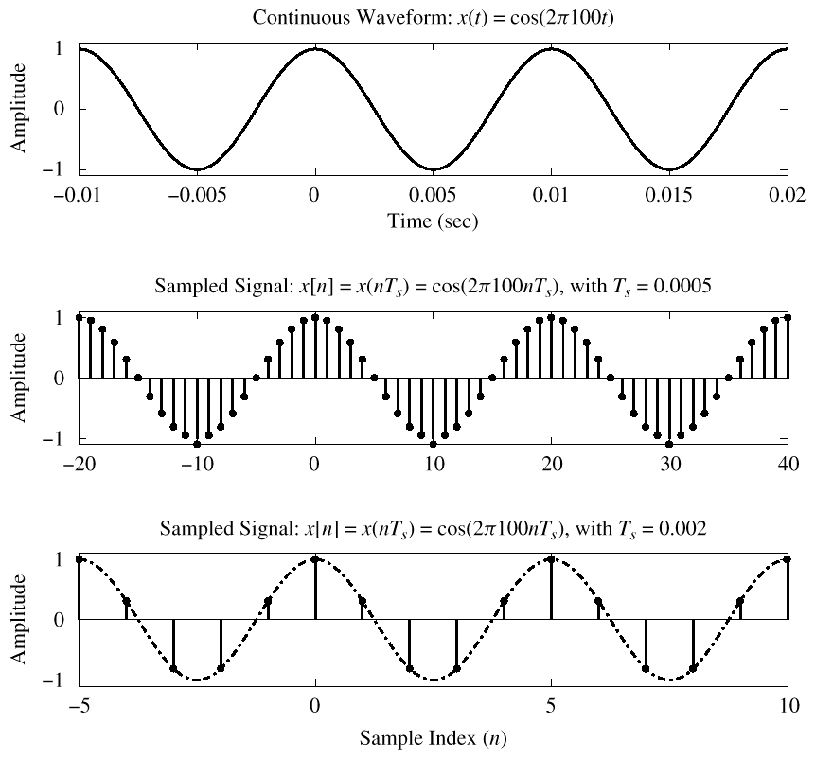



© 2003, JH McClellan & RW Schafer

Slide 9
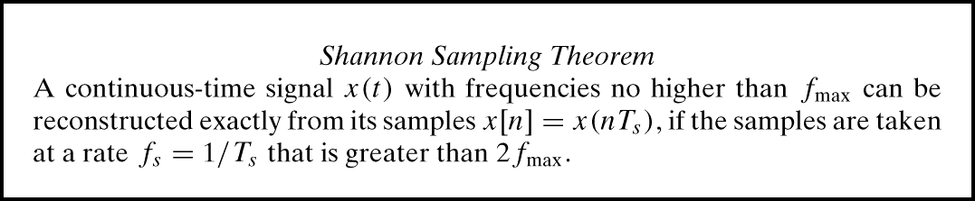
SAMPLING THEOREM
HOW OFTEN ?
  DEPENDS on FREQUENCY of SINUSOID
  ANSWERED by SHANNON/NYQUIST Theorem
  ALSO DEPENDS on “RECONSTRUCTION”
© 2003, JH McClellan & RW Schafer

Slide 10
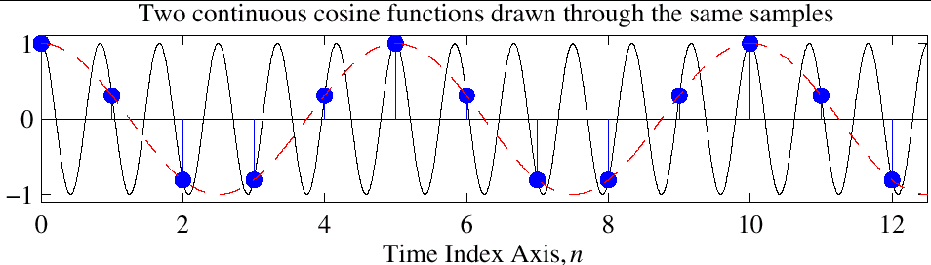
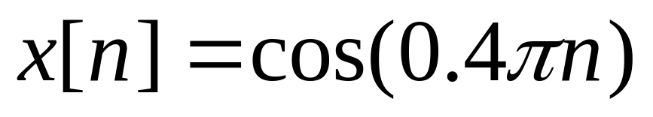
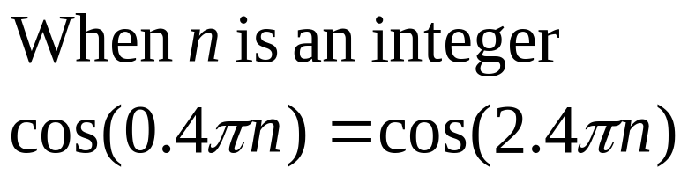
Reconstruction? Which One?
Given the samples, draw a sinusoid through the values
Fig. 4-4
© 2003, JH McClellan & RW Schafer

Slide 11
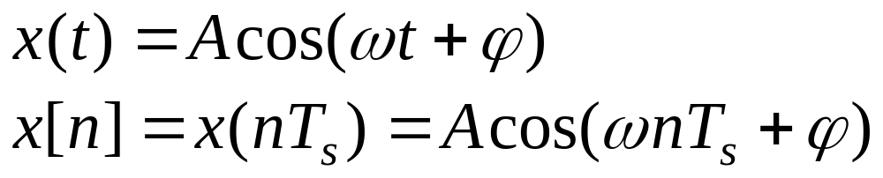
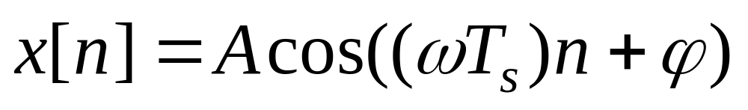
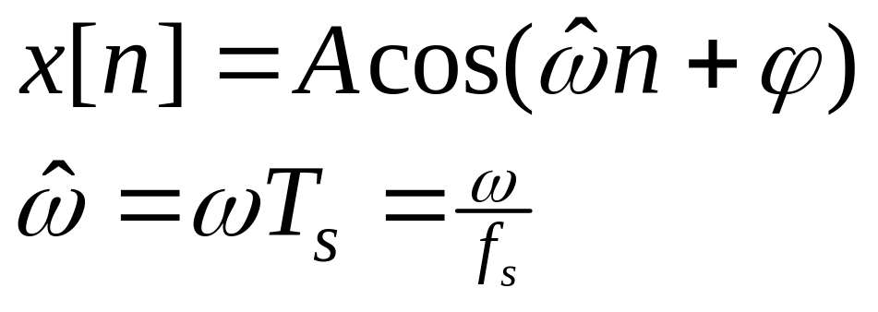
DISCRETE-TIME SINUSOID
Change x(t) into x[n] DERIVATION
DEFINE DIGITAL FREQUENCY
© 2003, JH McClellan & RW Schafer

Slide 12


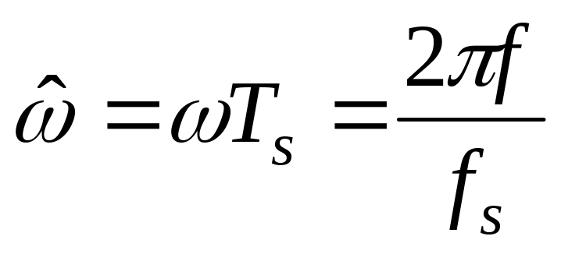
DIGITAL FREQUENCY
VARIES from 0 to 2π, as f varies from 0 to the sampling frequency
UNITS are radians, not rad/sec
  DIGITAL FREQUENCY is NORMALIZED
© 2003, JH McClellan & RW Schafer

Slide 13
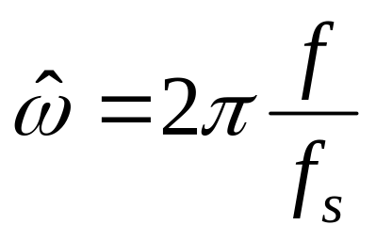
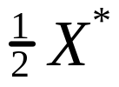

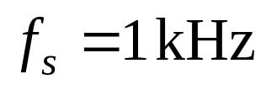

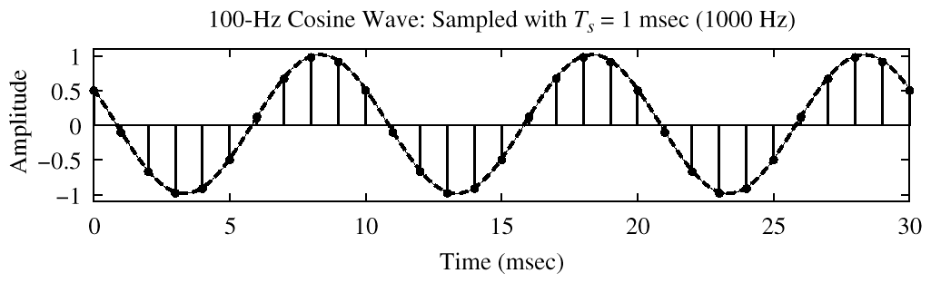
SPECTRUM (DIGITAL)
–0.2π
2π(0.1)
© 2003, JH McClellan & RW Schafer

Slide 14
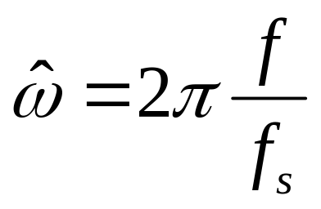

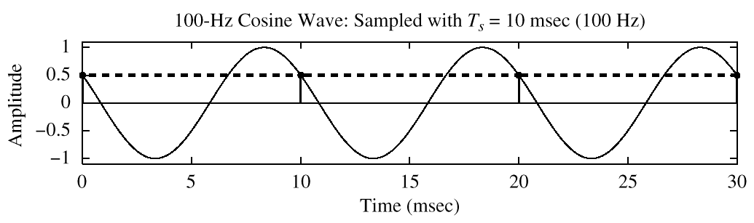
SPECTRUM (DIGITAL) ???
?
–2π
2π(1)
x[n] is zero frequency???
© 2003, JH McClellan & RW Schafer

Slide 15
The REST of the STORY
Spectrum of x[n] has more than one line for each complex exponential
  Called ALIASING
  MANY SPECTRAL LINES
SPECTRUM is PERIODIC with period = 2π
  Because
© 2003, JH McClellan & RW Schafer

Slide 16

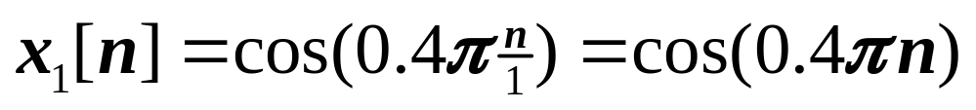
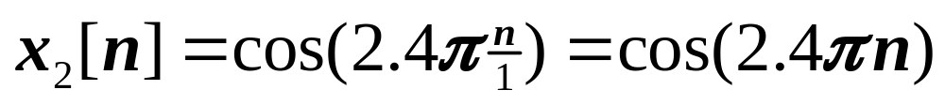
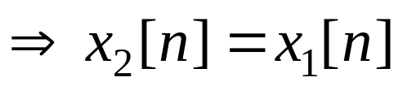

ALIASING DERIVATION
Other Frequencies give the same
© 2003, JH McClellan & RW Schafer

Slide 17
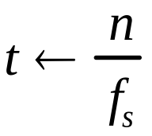
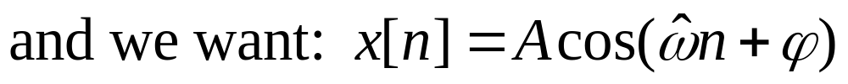
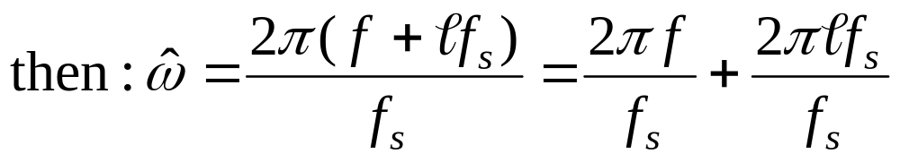
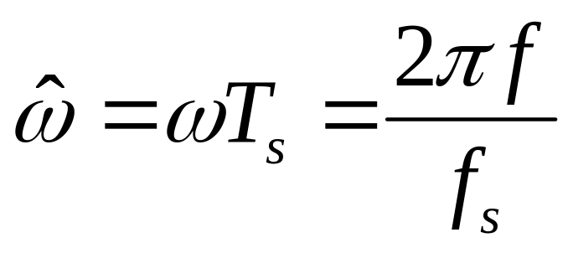
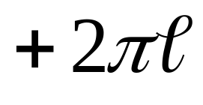
ALIASING DERIVATION–2
Other Frequencies give the same
© 2003, JH McClellan & RW Schafer

Slide 18
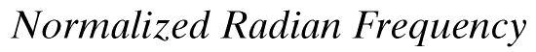

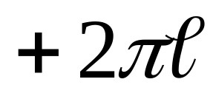
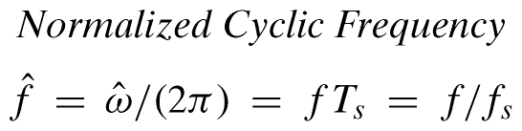
NORMALIZED FREQUENCY
DIGITAL FREQUENCY
© 2003, JH McClellan & RW Schafer

Slide 19
SPECTRUM for x[n]
PLOT versus NORMALIZED FREQUENCY
INCLUDE ALL SPECTRUM LINES
  ALIASES
    ADD MULTIPLES of 2π
    SUBTRACT MULTIPLES of 2π
  FOLDED ALIASES
    (to be discussed later)
    ALIASES of NEGATIVE FREQS
© 2003, JH McClellan & RW Schafer

Slide 20
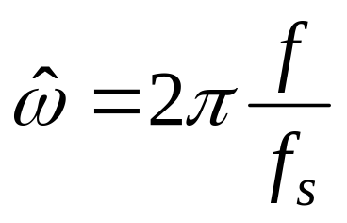
SPECTRUM (MORE LINES)
–1.8π
–0.2π
2π(0.1)
1.8π
© 2003, JH McClellan & RW Schafer

Slide 21

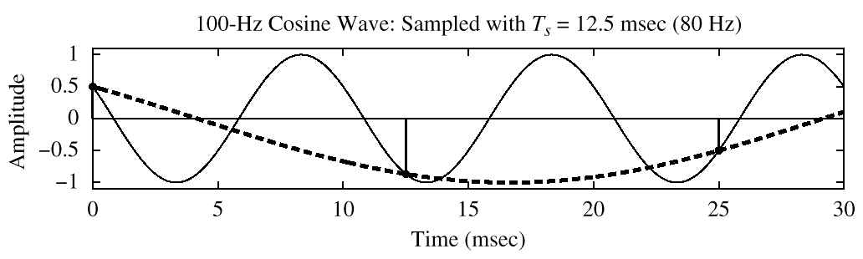
SPECTRUM (ALIASING CASE)
–2.5π
–1.5π
–0.5π
0.5π
1.5π
2.5π
© 2003, JH McClellan & RW Schafer

Slide 22
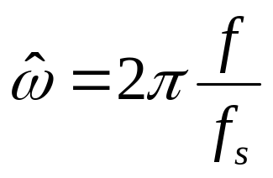

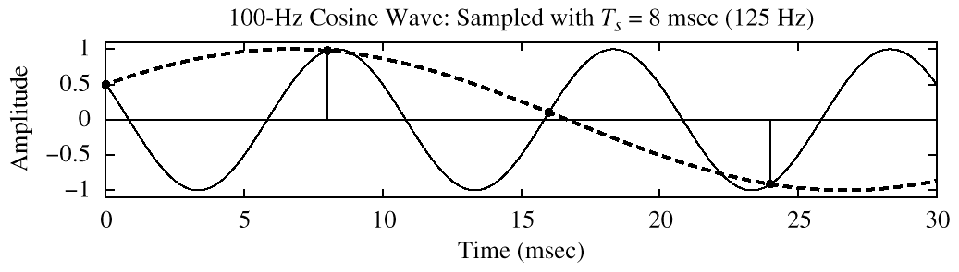
SPECTRUM (FOLDING CASE)
–1.6π
–0.4π
0.4π
1.6π
© 2003, JH McClellan & RW Schafer

Slide 23

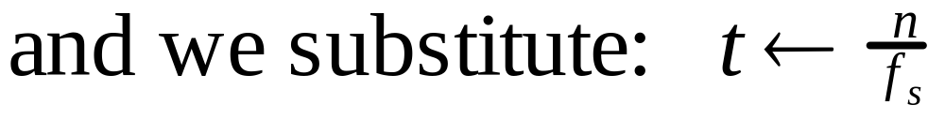
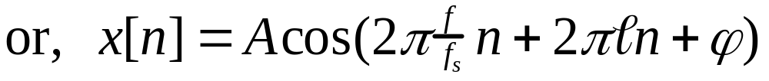
ALIASING DERIVATION
Other Frequencies give the same
© 2003, JH McClellan & RW Schafer

Slide 24
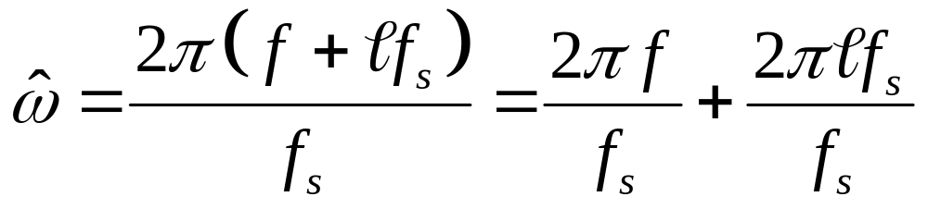
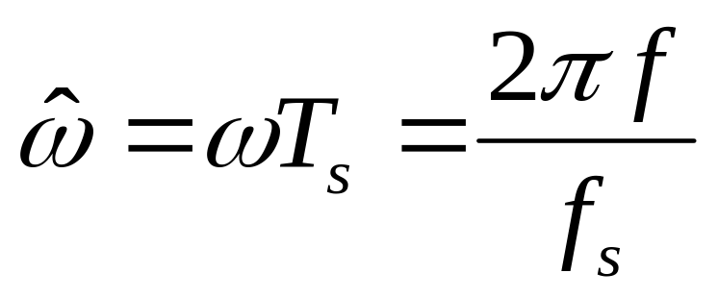
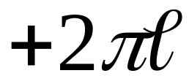
ALIASING DERIVATION–2
Other Frequencies give the same
then
© 2003, JH McClellan & RW Schafer

Slide 25
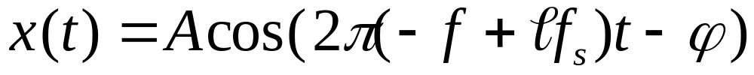

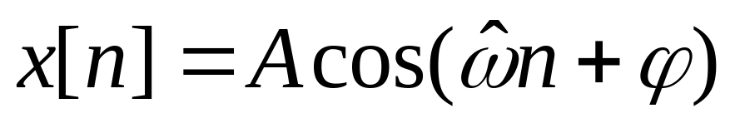
FOLDING DERIVATION
Negative Freqs can give the same
SAME DIGITAL SIGNAL
© 2003, JH McClellan & RW Schafer

Slide 26


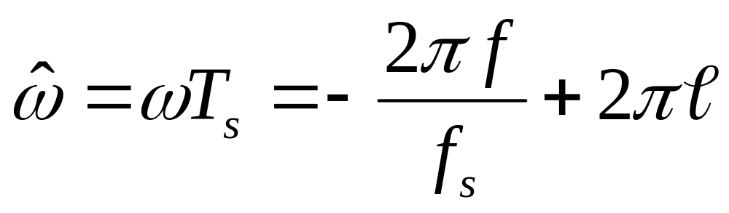
DIGITAL FREQ AGAIN
ALIASING
FOLDED ALIAS
© 2003, JH McClellan & RW Schafer

